Slide 1
Towards Autonomic Security Management of Healthcare Information Systems
By: Jordan Donovan

Slide 2
Introduction
Healthcare has seen an uptick in technology use
Healthcare Information Systems (HIS) are lagging in cyber security defense
Attackers are focusing on HIS because of this and the valuable information it holds
Barriers for cyber security in HIS
Lack of financial and professional resources
Large amount of emerging and new threats
The complex nature of network infrastructure
Autonomic Computing (AC) technology can be used to supplement the System Administrator’s responsibility to protect the HIS
This paper suggests an autonomic security management framework (ASMF) approach to self-protecting the HIS

Slide 3
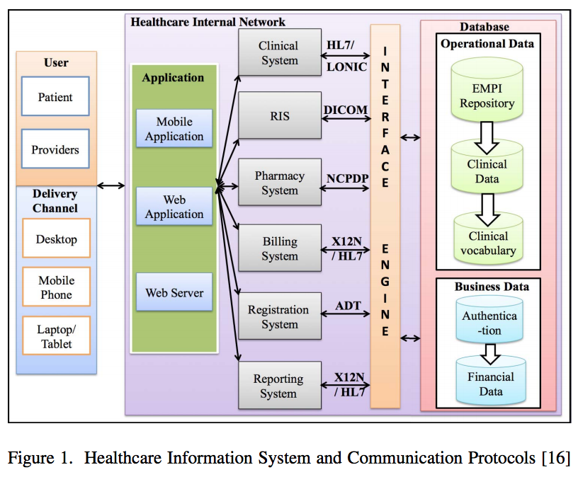
Healthcare Information System
Contains Financial Information Systems (FIS) and Clinical Information Systems (CIS)
3 tier architecture (web, application, and data tiers)
Notice the Communication Standards

Slide 4
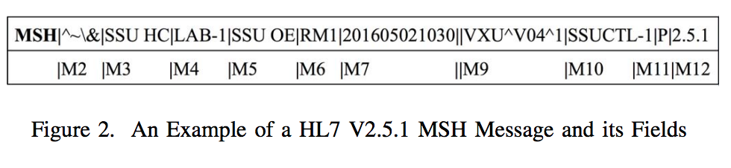
HL7 Messaging Standard
Health Level Seven (HL7) is a non-profit organization providing a comprehensive framework and developing standards for the communication of electronic health information
HL7 v2.5.1
Named best standard for admission, discharge, and transfer. It is very highly adopted.

Slide 5
Security Challenges in Healthcare Information Systems
Scanning Attacks
Attackers scan devices to gather network information, then launch an attack
Mitigation of these attacks includes closing ports not commonly used and updating protection rules to drop malicious requests to HL7 ports
Spoofing Attacks
Attackers pretend to be legitimate users
Mitigation: frequently change credentials and detect duplication
Injection Attacks
Attackers exploit vulnerabilities to gain access or attack system
Mitigation: message encryption, sender authentication, avoid SQL from users

Slide 6
Security Challenges in Healthcare Information Systems Continued
Broken Authentication and Session Management
Exploit authentication vulnerabilities to assume user’s identities
Mitigation: Strictly limit account access attempts and add IP address to detection rules for future filtering of malicious requests
Denial of Service Attacks (DoS)
Attackers attempt to exhaust system and/or network resources
Mitigation: Hide systems from users, redirect flooding messages to honeypots, update detection and protection rules

Slide 7
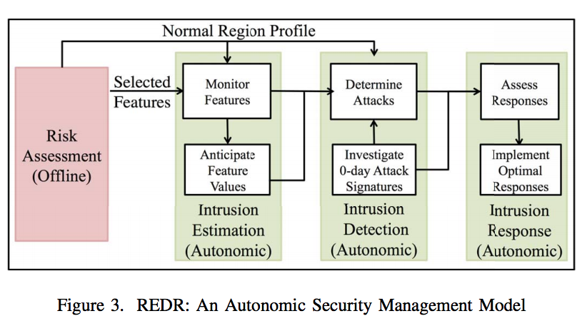
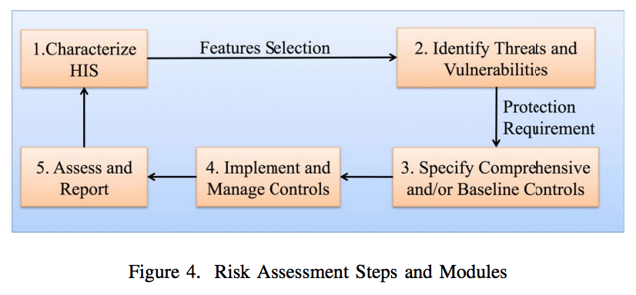
Designing a Self-Protection Healthcare Information System
REDR framework
Risk Assessment
Analyze and characterize HIS performance; Establish normal region
Identify threats and vulnerabilities from output
Select security controls
Implement security controls
Assess the success of controls and report
Intrusion Estimation
Continuously monitor features and compare to normal region
Intrusion Detection
Detection of known and unknown attacks
Intrusion Response
Mitigate attacks and restore system to normal behavior

Slide 8
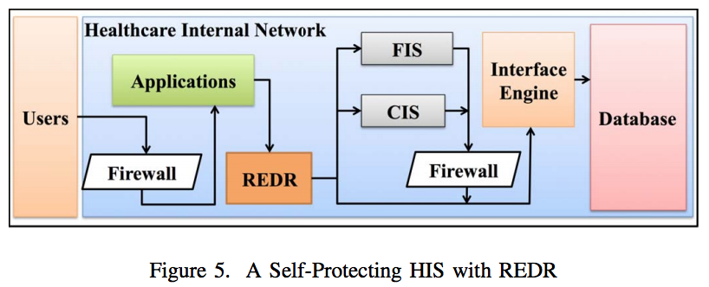
Applying REDR Modules to Secure Healthcare Information System
Firewall filtering
Requests are then monitored by Intrusion Estimation Module (IEM)
If attacks pass IEM, Intrusion Detection Module (IDM) will detect them and update detection rules in IDM
Intrusion Response Module (IRM) is then activated to respond to the attack
Internal Firewall for internal illegitimate requests

Slide 9
Conclusion and Future Work
Large amount of cyber attacks to vulnerable HIS
AC technology can help immensely by:
Integrates real-time monitoring and management solutions
Proactively assess system risks
Reports early warning signs
Prevent known attacks
Learn new attacks and protect from them
Future Work
Establish HIS testbed and assess risks
Baseline control implementation
Exploit five vulnerabilities examined in paper
REDR ASMF designed and implemented to protect HIS

